Slide 1
Multi-Class Classification – Cancer Diagnosis Case Study

Slide 2
Table of Contents
Introduction
Objective of the case study
Data description
Exploratory Data Analysis
Univariate Analysis
Machine learning models
Conclusion & Recommendations
Visualization

Slide 3
Introduction
This dataset is provided by Memorial Sloan Kettering Cancer Centre (MSKCC). This dataset was a part of Neural Information Processing System (NIPS) 2017. We are given sequence of thousands of genetic mutation (Mutations are small changes in the gene that can corrupt the genetic code). Considering this information we have to classify the mutations that contribute to tumour growth (drivers) from the neutral mutations (passengers).

Slide 4
Objective of the case study
Our objective is to AUTOMATE the classifications of mutations based on evidence from text based clinical literature. Since we have 9 classes this is a multi-class classification problem.
Currently this interpretation of gene is done MANUALLY. This is very time consuming task where a PATHOLOGIST has to manually review and classify every single genetic mutation based on evidence from text based clinical literature.

Slide 5
Business Constraints
Based on the data and our objective a few business constraints are listed out:
No low latency requirement : Given an input we need not provide the class label within very short span of time (like in few seconds or minutes). We can take reasonable time to provide an output.
Interpretability of the model is important: As we are dealing with critical dataset we need to understand as to why we have classified a data point to a certain class label. So our models need to be very interpretable.
Probability value : Probability of a data point belonging to each class is required.

Slide 6
Data Description
Source of the data is : https://www.kaggle.com/c/msk-redefining-cancer-treatment/data
We have two datasets:
a) Training_variants : This dataset has 4 columns, & 3321 rows. It contains ID, Gene Code, type of variation and class labels[1-9]
b) Training_text : This dataset has 2 columns & 3321 rows. It contains ID, clinical evidence that pathologist use to classify mutations.
PLEASE NOTE: We are not given which class labels has Cancer or not. (Refer :(https://www.kaggle.com/c/msk-redefining-cancer-treatment/discussion/35336#198543)

Slide 7
Exploratory Data Analysis
We have 3 features that are very important to our analysis – Gene code, Variation & Clinical text.
We split the data randomly as follows : Train - 64%, CV - 16% and Test - 20%.
We have pre-processed these features especially text feature using basic NLP procedures like removing stop-words, replacing special characters, converting the text to lower, splitting the text. Gene code & variation feature was pre-processed replacing multiple spaces with underscore and so on.
We build a random model such that, any sensible model built later on should have less value than that of RANDOM model. Our random model has a log-loss of 2.5

Slide 8
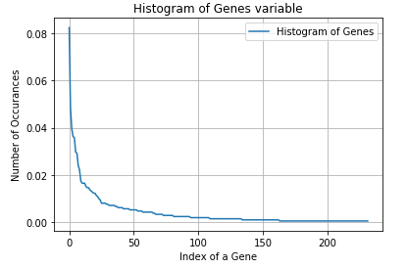
Univariate Analysis
Univariate analysis on Gene feature
Gene feature is a categorical feature taking 235 distinct categories of genes.
When we plot the histogram of Gene variable we observe a very skewed distribution and very few genes occur frequently.

Slide 9
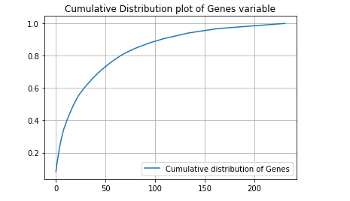
Univariate Analysis
When we plot the Cumulative Distribution of Gene variable then, we can say that top 50 genes contribute to 75% (approx) of data.
We have also trained a logistic model using Gene feature to understand how good Gene feature is in predicting yi’s. Log-loss was 1.2 which is far better than random-model.
Similarly we perform univariate analysis on other two features – Variation and Text.

Slide 10
Machine learning models
Performance metric(s): a) Multi-class log loss: As a business constraint we wanted outputs to be based on actual probability values. And when we have outputs based on probabilities one of the good loss functions we can use is log-loss. b) Confusion Matrix: Confusion matrix provides us a better interpretable option.
Before applying machine learning models our data is featurized using a) One hot encoding: Using tf-idf we have featurized our gene,variation and text data. b) Response coding: We use response coding also to featurize our data.

Slide 11
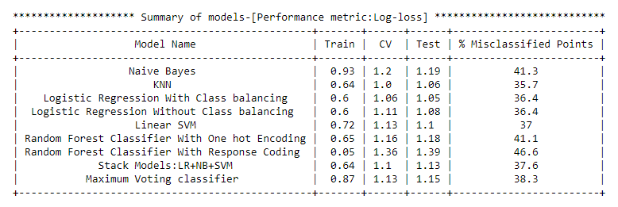
Machine learning models
We have performed an array of models and the performance metric is as follows:

Slide 12
Conclusion & Recommendation
Summary of the above table:
1) From the above table we have KNN, Logistic regression(Class Balancing), Logistic regression (without balancing) models having log-loss very close to 1. So, when we compare these three models: Logistic regression(class balancing) is a better choice of model because: a) It can handle large dimension of data. b) It can provide feature importance which is very important. Also when we consider % of misclassified points, Logistic regression is very close to what KNN model offers us.
2) Random Forest (with response coding) overfits our CV & test by a huge margin. Also it has highest percentage of misclassified points.

Slide 13
Conclusion & Recommendation
Having seen the performance of all the models we can suggest Logistic Regression(class balancing) as our go to model in deployment stage. Because as discussed above logistic regression can provide feature importance as compared to KNN. Hence we can go ahead with Logistic regression model.

Slide 14
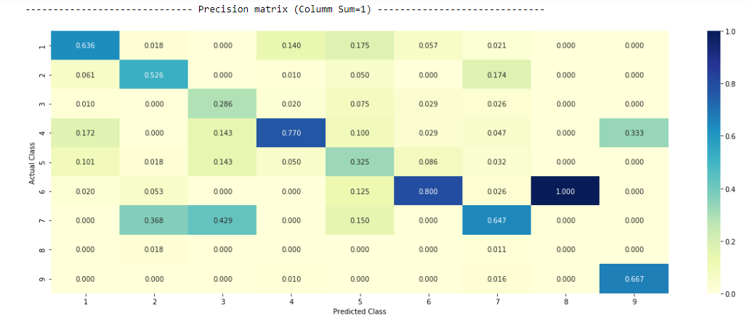
Visualization (Precision Matrix)
Logistic regression (class balancing) visualization: Precision Matrix
When we consider 3rd col & 7th row of the precision matrix we get a value of 0.429 (42.9%) this means of all the points predicted to be of class 3, 42.9% of the points actually belong to class 7.

Slide 15
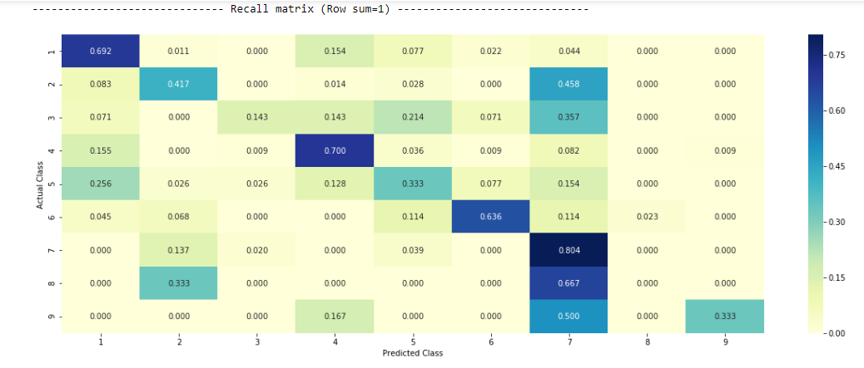
Visualization (Recall Matrix)
Logistic regression (class balancing) visualization: Recall Matrix
When we consider 7th col & 8th row we get a value of 0.667 (66.7%) which means that of all the points that actually belong to class 8, of them 66.7% of points are predicted to be of class 7.

